Slide 1


City of Emeryville Climate Action Plan 2.0
Hoi-Fei Mok
Environmental Programs Intern
November 15, 2016

Slide 2

Why Are We Updating the
Climate Action Plan?
It’s Required:
  State legislation/targets
  National and international agreements
  Local direction: City Council & community
Our Vulnerability:
  Sea level rise & extreme weather events
  Emergency planning, police & fire services
  Impacts: public health, transportation, infrastructure, pollution levels, power, security, costs, jobs
Leadership:
  For our community and other jurisdictions
  New technology & methods to consider
Notes:
State target:40% reduction below 1990 levels by 2030, 80% reduction below 1990 levels by 2050. State also requires us to include climate action adaptation into local hazard mitigation planning.
We’ve signed on to the international Compact of Mayors, agreement btw local city governments to develop & implement a CAP and set GHG reduction targets.
Vulnerabilities: sea level rise, increasing air pollution from traffic smog, extreme weather events like heat/storm/flood, public health impact from pollution/heat/disease, aging infrastructure, energy security, increasing costs to maintain status quo, transportation needs & fuel, food security

Slide 3
CAP 2.0 Outline
Greenhouse gas (GHG) reduction targets for 2030 and 2050
Updated community and municipal GHG inventories
GHG emissions forecast for “business as usual” scenario
Hazard vulnerability assessment (427 Climate Solutions)
Climate mitigation action plan for 2030
Climate adaptation action plan for 2030
Vision for 2050
Monitoring plan for checking in on initiatives progress

Slide 4
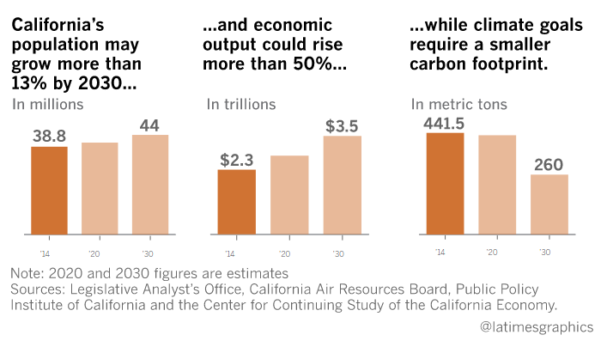
Mitigation Targets
40% reduction of GHG emissions over baseline levels by 2030
80% reduction of GHG emissions over baseline levels by 2050
Backed by Governor Brown’s Executive Order B-30-15 and Senate Bill 32

Slide 5
Community & Municipal
GHG Inventories for 2014
Community Inventory
  Total of 172,146 mt CO2 all traffic and 120,194 mt CO2 local traffic
  18.53% decrease in CO2/person including all traffic
  30.71% decrease in CO2/person including local traffic
  Overall, 7.84% decrease in emissions (10,224 mt CO2) including local traffic
Municipal Inventory
  Total of 1,643 mt CO2
  Overall, 7.29% reduction in emissions (131 mt CO2) from 2010 to 2014 and 11% reduction from 2004 on comparable data
  Large increase in employee commute between 2010 and 2014 (52.83%); biggest contributor to municipal emissions (25.89%)

Slide 6
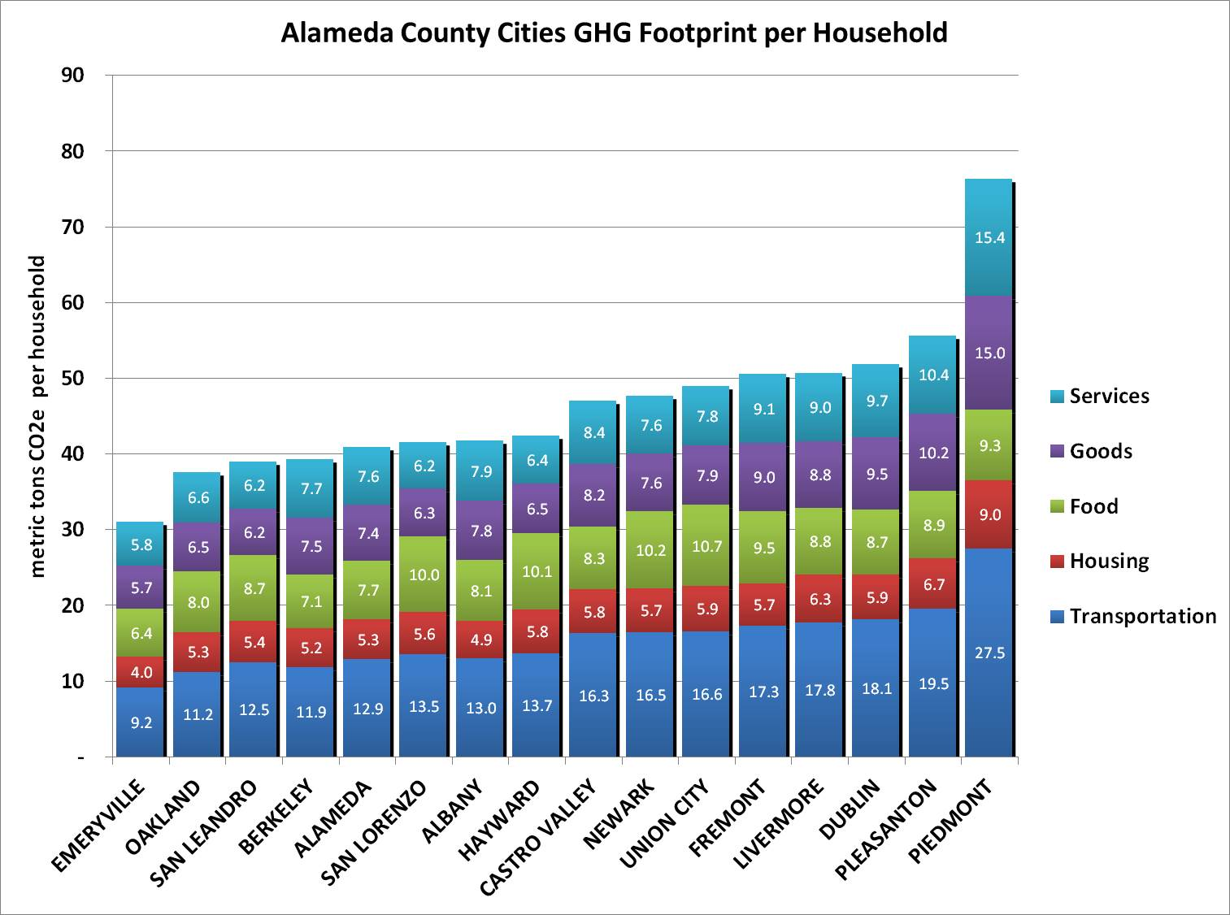
Bay Area “Consumption” GHG Study
Emeryville has the lowest per-household carbon footprint for the Bay Area at 30.41 mt CO2, compared to 44.3 mt CO2 for the Bay Area average

Slide 7
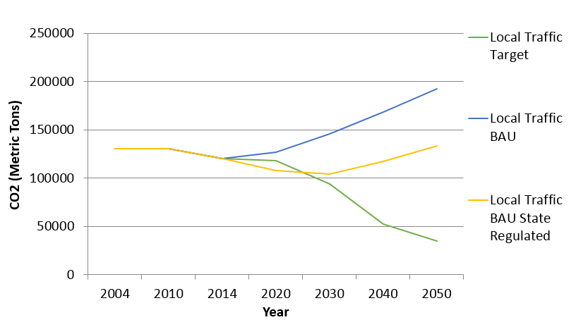
GHG Emissions Forecast:
Local Traffic Scenario

Slide 8
Modeled sea level rise for Alameda County
Scenario: Daily tidal inundation and 8 feet of flooding, can occur with 100 yr flood and 4.5 feet sea level rise (end of century)
From Adapting to Rising Tides: Alameda County Shoreline Vulnerability Assessment, May 2015

Slide 9
Climate Hazard Vulnerability Assessment
Sea level rise is major issue
  High Impact Assets: Freeway Exchange, Fire Station 34, Railroad (Park/Bay St), Wastewater Treatment Plant, Irrigation Backflow Facility, Storm Sewer Gravity Main (Peninsula, Park/Bay St)
  Majority of facilities not affected until 48 or 72 inches of sea level rise
Trend for warmer weather overall; 4-32 extreme heat days/year to be expected
Flooding could be an issue along peninsula, given enough rain
No major threats from fires

Slide 10
Objectives for 2030
Transportation
Buildings
Energy
Consumption and Waste
Water Use
Urban Space
Local Government Operations
Adaptation

Slide 11
Deep Decarbonization Strategies for 2050
Decarbonizing energy supply
  Eliminating natural gas use
  Decarbonizing electricity supply (ie through Community Choice Energy)
  Local buildout of solar and wind production
Low carbon transportation
  Expansion of electric vehicle infrastructure and public transit
On-going research and innovation
  Consumption-based inventorying & other metrics
  Circular economy → designing buildings for deconstruction/electrification
Community education and awareness
  Creating resilient neighborhood blocks

Slide 12
Monitoring Plan Timeline
Reporting to Covenant of Mayors every 2 years
Full reports every 4 years
Monitoring Report Component | 2018 Reporting | 2020 Reporting | 2022 Reporting
Overall Strategy: Reporting any changes to initial strategy as well as updated information on human and financial resources | Yes | Yes | Yes
GHG Emissions Inventories: Provide updated energy consumption and GHG emissions data for the reporting year | No | Yes | No
Mitigation and Adaptation Action Plans: Report the implementation status (completed, in progress, on hold) of key actions and update their impacts | Yes | Yes | Yes

Slide 13

Emeryville’s Current Impacts
-35%
-1681 cars
⁺344%
14%
Decrease in community solid waste disposal 2004-2014
CO2 averted from PG&E programs community-wide since 2006
Increase in Bike to Work Day participation since 2000
Average monthly energy savings from solar at City Hall 2006-2012
Gold Level Beacon Award Winner
Selected for Office of Planning and Research’s Best Practices Pilot Program
“Most walkable city” by East Bay Economic Development Alliance
Certified as “Bicycle Friendly Community - Silver Level” in 2016
Launching BikeShare: 100 bikes in Emeryville to start
28 businesses in Green Business Certification Program
Lowest per-household carbon footprint in 2015 BAAQMD/UC Berkeley study of Bay Area

Slide 14
Alameda County
CAP 2.0 Updates
City | Planned Adoption Year | GHG Targets
Alameda
Albany | 2017/2018 | 60% by 2035 + Carbon Neutral by 2050
Berkeley | TBD | 80% by 2050
Dublin | 2017/2018 | 2030 + 2050
Emeryville | 2016 | 40% by 2030 + 80% by 2050
Fremont | 2017/2018 | 40% by 2030 + 80% by 2050
Hayward | TBD | TBD
Livermore
Newark
Oakland | TBD | 40% by 2030 + 80% by 2050
Piedmont | 2018 | 2030
Pleasanton
San Leandro | 2017/2018 | TBD
Union City | TBD | TBD
Unincorporated County

Slide 15
Climate/Sustainability Programs
Underway
Continuing or Planned
Climate adaptation in Local Hazard Mitigation Plan (LHMP)
Property Assessed Clean Energy (PACE) Financing
Energy efficiency upgrades at city facilities
Green Team formation
Bike Share program
Outreach on energy opportunities and waste management
Voluntary Commercial Building Audit Program with ABM
Bay Area SunShares Program
Office of Planning and Research’s Best Practices Pilot Program
Compact of Mayors reporting
Alameda County Community Choice Energy (CCE)
Food procurement policy at Emeryville Center of Community Life
Sustainable consumption outreach campaign
City facilities waste audit
Building Energy Savings Ordinance (BESO)
Electric vehicle (EV) charging stations at City Hall
Green Infrastructure Plan
Solar carport at City Hall
Environmentally Preferable Purchasing
Best value bidding, including environmental impact
Commute Benefits for Employees
Regional sea level rise study and action
Community engagement training

