Slide 1
Sutter Hospital Medical Center
City Council Study Session
Tuesday, July 21, 2026
Agenda Number 3.1
Location: 5300 Chiron Way
Project: Amendment to Chiron PUD/PDP, General Plan Amendment
Applicant: Sutter Health (c/o Vahram Massehian)
Community Development Department

Slide 2
Presentation Outline
Process & Regulatory History
Project Overview
General Plan/Zoning
Environmental Review
Community; Committee and Staff Comments
Permits and Process
Issues to Consider
Staff
Sutter Team
Staff
City Council
Community Development Department

Slide 3
Pre-Application Meeting
Application Submittal Apr 2026
determine appropriate level of environmental review
Begin CEQA Process
Public Scoping Meeting Aug 27
Prepare Draft EIR
Notice of Preparation (NOP) Aug 10 – Sep 9
Release Draft EIR - 45 days
Response to Comments (RTC) and Final EIR
Community Meeting May 18
Committee Review
PC Study Sessions
CC Study Sessions
Community Input, PUD Amendment, General Plan Amendment
CEQA

Slide 4
Continued from previous slide…
PC Public Hearing – recommend CC:
- Certify EIR
- Approve PUD Amendment/GPA
CC Public Hearing:
- Certify EIR
- Approve PUD Amendment/GPA
Response to Comments
(RTC) and Final EIR

Slide 5
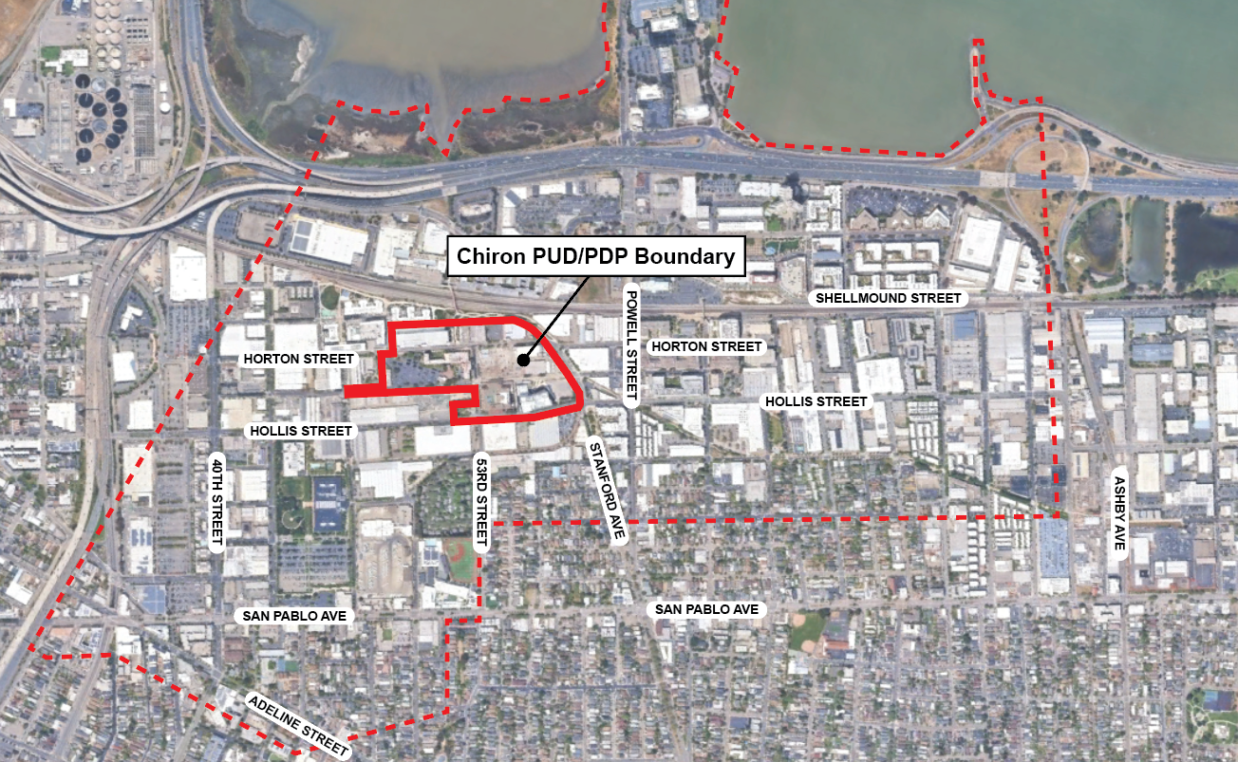
Project Location

Slide 6
Regulatory History (Chiron)
1995: City approves Chiron PUD/PDP for a life science campus
1996-2005: Chiron builds lab building, utility plant, parking structure
Community Development Department

Slide 7
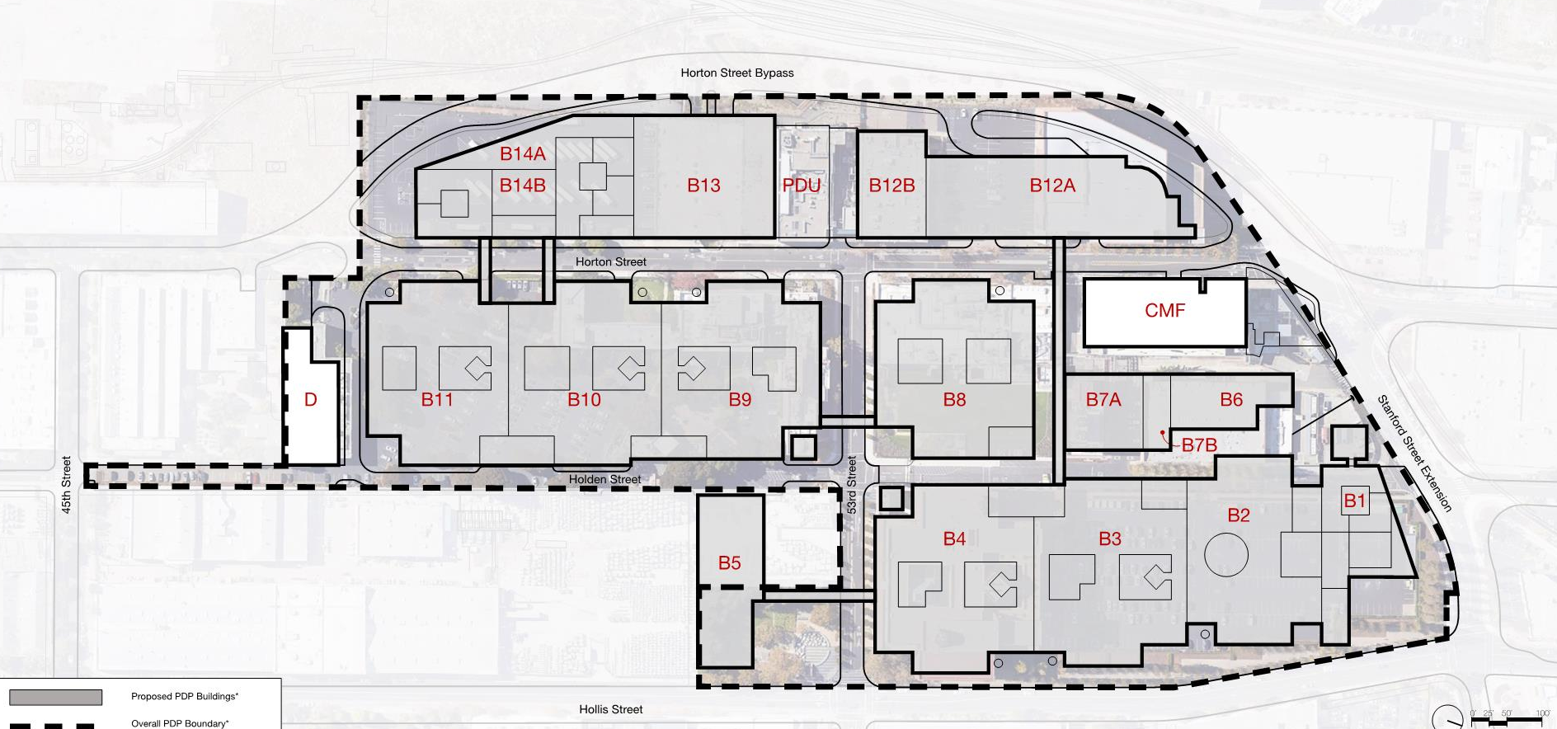
Chiron PUD/PDP Build-Out
14 new buildings:
7 labs; 3 office towers, structures parking and support facilities

Slide 8
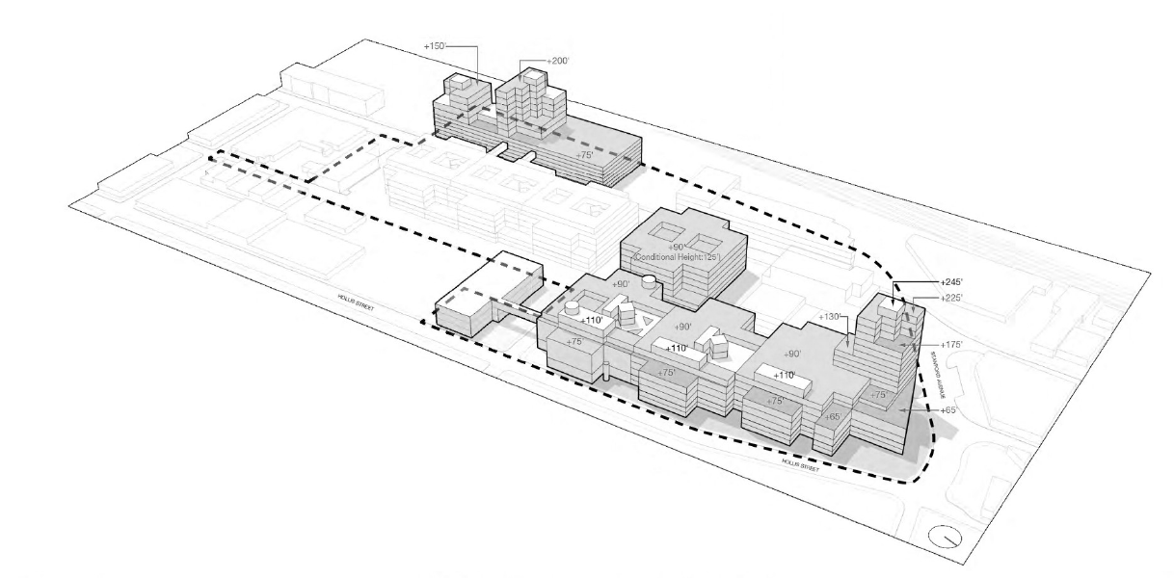
Chiron PUD/PDP Massing

Slide 9
Regulatory History (Novartis)
2006: Chiron sells PUD/PDP to Novartis
Novartis builds Hollis Green
2013: Novartis sells portion of PUD/PDP to Grifols
2019: Novartis sells remaining portion of PUD/PDP to Biomed Realty (BMR)
Community Development Department

Slide 10
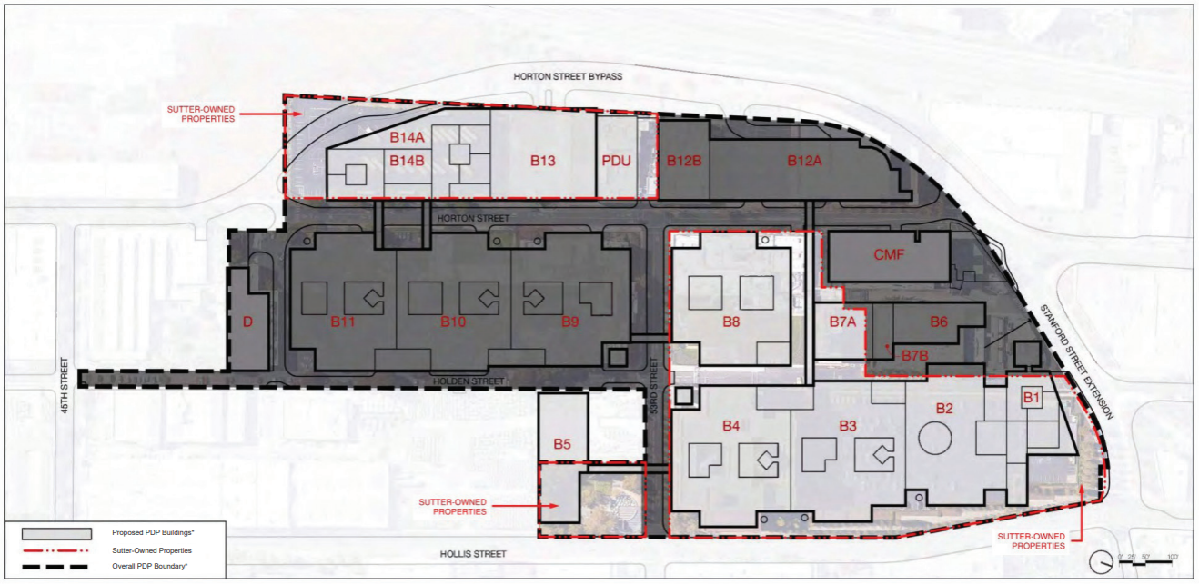
Grifols/BMR Ownership
GRIFOLS
BMR

Slide 11
Regulatory History (BMR)
2021: City approves BMR’s FDP for parking structure and four R&D buildings
2023-2024: BMR builds parking structure and one R&D shell building, renames campus “Emery Yards”
Community Development Department

Slide 12
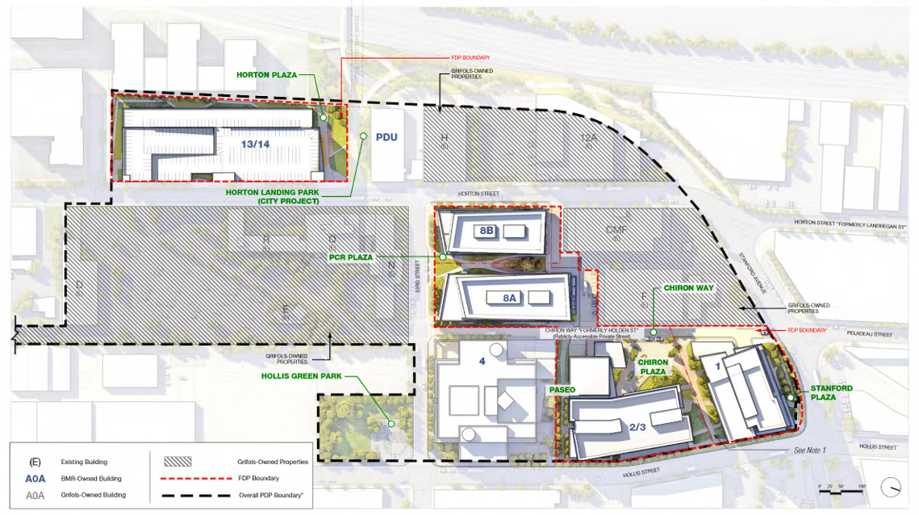
BMR Development

Slide 13
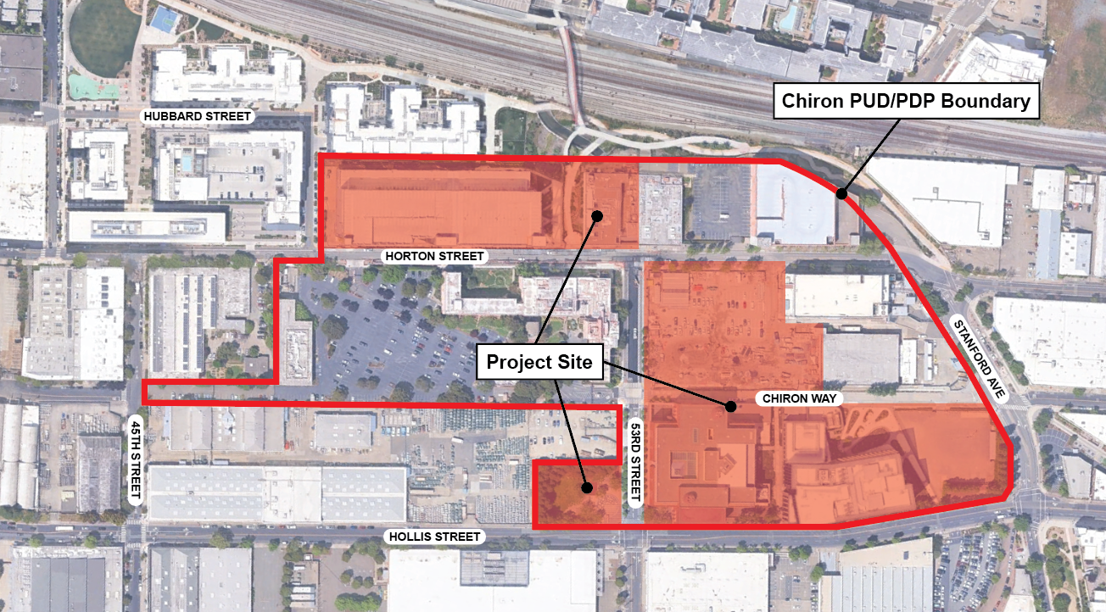
Sutter Controlled Parcels

Slide 14
Sutter Proposal
New buildings
  B8 – 325-bed hospital
  B1 – Medical office or housing, with parking
Existing buildings
  B4 – medical office/support space
  B2/3 – medical office/clinics
  “PDU” site/Hollis Green/shuttle depot
  B13/14 – parking structure

Slide 15
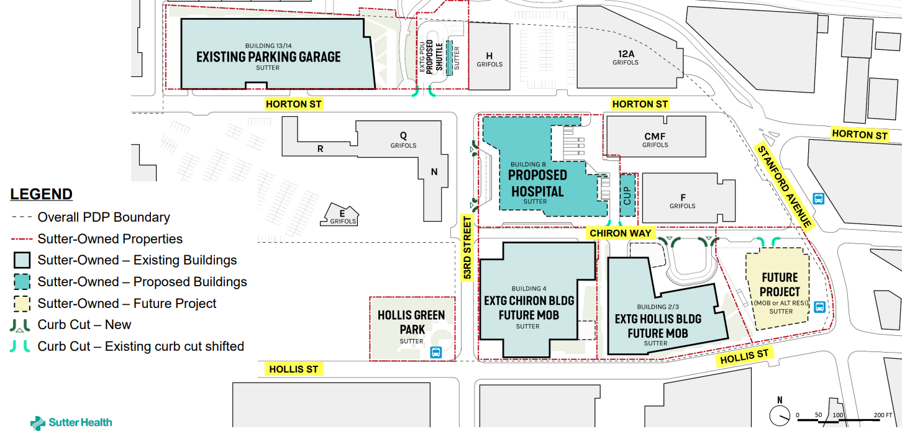
Sutter Proposal, cont.

Slide 16
Project Overview
Sutter Team

Slide 17
Construction Schedule
Building | Start Work | Construction Time | Construction Phase
B2/3 (5555 Hollis St) medical office/clinic | 2 months after PUD approved | 21 months | Q3 2027 – Q4 2029
B8 new hospital | FDP submittal after PUD approved | 71 months | Q3 2028 – Q4 2033
B4 (5300 Chiron Way) medical office/support | After hospital is built | - | Q3 2034 – Q4 2035
B1 new medical office/ housing | After hospital is operating (Use for construction coordination in interim) | 24 months | TBD

Slide 18
Preliminary General Plan/Zoning Analysis
 | Permitted | Proposed
General Plan Land Use | Office/Technology, Park/Open Space | Hospital/medical office
Zoning | PUD-3 – Chiron PUD/PDP | Hospital/medical office*
Height | 225 ft – Chiron PUD/PDP 50 ft/100 ft (bonus) – General Plan | 330 ft*
Build-Out | 2.2m sf – Chiron PUD/PDP | 1.69m sf (Sutter + Grifols)
Parking | 0.81 spaces per employee – PUD/PDP | 0.73 spaces per employee
*exceeds/not consistent with existing PUD/PDP

Slide 19
Preliminary General Plan/Zoning Analysis, cont.
PUD amendment needed to allow hospital/medical office use
General Plan amendment needed to allow maximum height of 330 feet
Project will be evaluated against other Chiron PUD/PDP requirements (e.g., trees, landscaping, setbacks)

Slide 20
Environmental Review
City must prepare an Environmental Impact Report (EIR) under CEQA to:
  Evaluate and disclose potential environmental impacts
  Consider mitigation measures and alternatives
City consultant, Urban Planning Partners (UPP), will prepare the EIR

Slide 21
Environmental Review, cont.
Topics covered by the EIR:
  Land Use
  Transportation
  Air Quality
  Greenhouse Gas Emissions
  Energy
  Cultural Resources and Tribal Cultural Resources
  Geology and Soils
  Hazards and Hazardous Materials
  Hydrology and Water Quality
  Noise and Vibration
  Population and Housing
  Public Services, Recreation, and Utilities
  Biological Resources
  Aesthetic Resources (Wind, Shade, Shadow)
  Project Alternatives

Slide 22
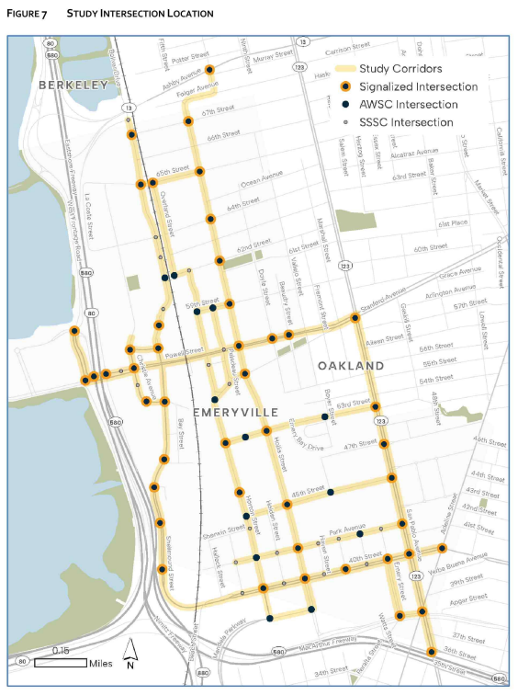
EIR Study Intersections
65th St
Hollis St
Overland St
79 study intersections
Powell St
Shellmound St
43rd St
San Pablo Ave
Horton St
Hollis St
45th St
Park Ave
40th St

Slide 23
Meeting Schedule
Meeting | Date & Time | Location
Sutter Health Community Meeting | May 18, 6:00 PM | 5300 Chiron Way
Bicycle/Pedestrian Advisory Committee | June 1, 5:30 PM | Civic Center
Commission on Aging | June 10, 10:00 AM | ECCL
Parks and Recreation Committee | June 17, 6:00 PM
Planning Commission – Study Session | June 25, 6:30 PM | Civic Center
City Council – Study Session | July 21, 6:00 PM
Planning Commission – EIR Scoping Meeting | August 27, 6:30 PM
Additional Study Sessions with the City Council and the Planning Commission are
anticipated and will be scheduled in the coming months.

Slide 24
Community & Committee Comments
Traffic impacts:
  Bike and pedestrian safety (lighting, traffic conflicts)
  53rd Street (impacts on Emery Bay Village, school)
  Horton Street (diverter removal, Stanford intersection)
  Parking spillover and access
Want more information on proposed shuttle service
  Integration with existing transit
  Bus shelter improvements

Slide 25
Community & Committee Comments, cont.
Want Sutter to provide broader community value, such as:
  Senior programming
  Public open space and amenities
Other topics:
  Proposed height and massing
  Noise impact on wildlife
  Landscaping/tree replacement

Slide 26
Planning Commission Comments
Horton Street Traffic Diverter
  No bike infrastructure to compensate for removal
  Intractable bollards for emergency/shuttle access
  Right turn only restrictions on 53rd Street
Shuttle Coordination with ETMA
Larger workforce housing on B-1
Explore creative ways of using existing parking at Bay Street and Grifols garage
Helipad/Noise and Light Pollution

Slide 27
Staff Comments
Transportation Impacts
Recommend the applicant offer more context on bike/ped improvements, impact of removing the diverter
Recommend the applicant align project description more with regional transportation planning

Slide 28
Staff Comments
Transportation Impacts, cont.
Transportation analysis should evaluate:
  Removal of diverter
  Bike/ped barriers due to proposed circulation
  Multimodal conflict locations and interactions
  Effects on 53rd and Horton bicycle boulevards
  Interaction between proposed shuttle and existing transit
  Interaction between multimodal network and driveways, loading, drop-off, shuttle, and emergency access
  Consistency with City transportation policies and plans (e.g. ATP, LRSP, General Plan)

Slide 29
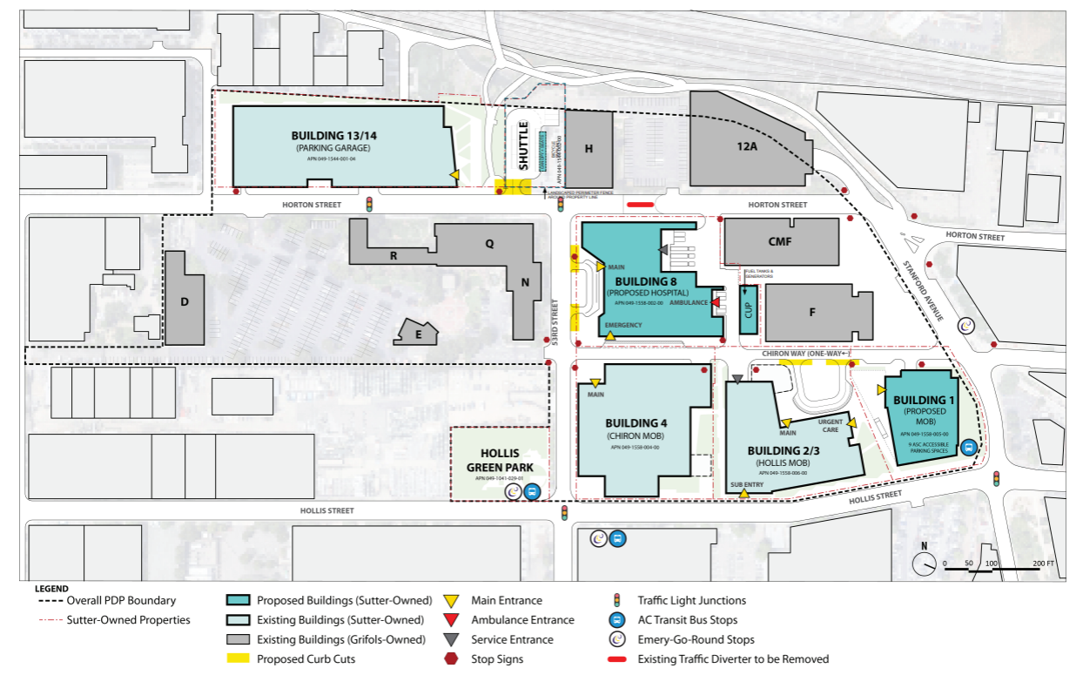
Staff Comments
Housing Variant
Encourage applicant to consider a larger workforce housing proposal at site B1
B1

Slide 30
Staff Comments
Community Benefits
City may evaluate issues outside of EIR and in addition to City requirements
  Staff is engaging fiscal consultant to evaluate campus’ impact
Agreed-upon benefits may be memorialized in Development/Community Benefits Agreement

Slide 31
Staff Comments
Community Benefits, cont.
Potential topics for community benefit:
Transportation improvements
Public realm improvements
Senior programming
Educational partnerships
Public art
Mobile food vendors
Childcare services

Slide 32
Permits and Process
Planning Commission makes recommendation, City Council approves:
  EIR certification
  PUD Amendment
  General Plan Amendment
Other permits may include:
  Final Development Plan
  Tree removal
  Development/Community Benefit Agreement

Slide 33
Council feedback

Slide 34
Does the Council have any comments or direction on the circulation plan and transportation improvements?
  Bicycle and pedestrian improvements
  Driveway/drop-off/loading/emergency access
  Operation of shuttle system
  Opportunities to coordinate shuttle with existing transit/transportation services

Slide 35
2. Has the Council identified any potential impacts on fiscal, public service, or public health, safety and welfare issues that would not be addressed through the CEQA process?

Slide 36
Does the Council have any comments on the proposed scale of the housing variant proposed at the B-1 site?
  Should the applicant evaluate a larger workforce housing alternative or other site program?
B1

Slide 37
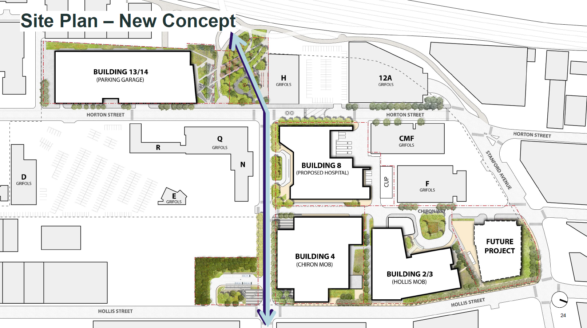
Does the Council have any input on the design of the shuttle depot proposed at Hollis Green?
Shuttle Depot

Slide 38
5. Does the Council have any other comments or direction regarding the project?

Slide 39
QUESTIONS?

Slide 40
Appendix

Slide 41
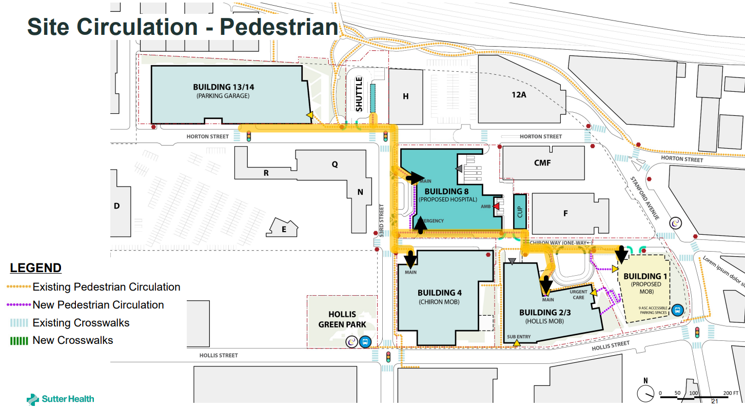

Slide 42
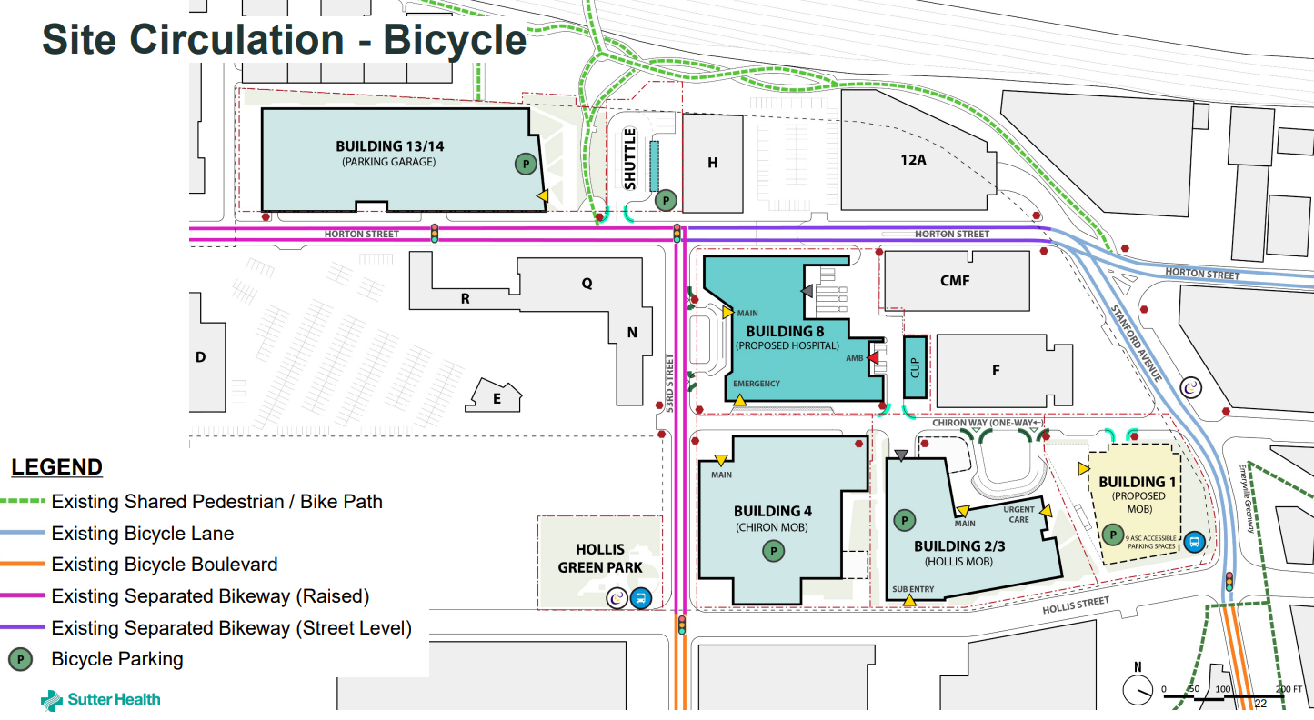

Slide 43
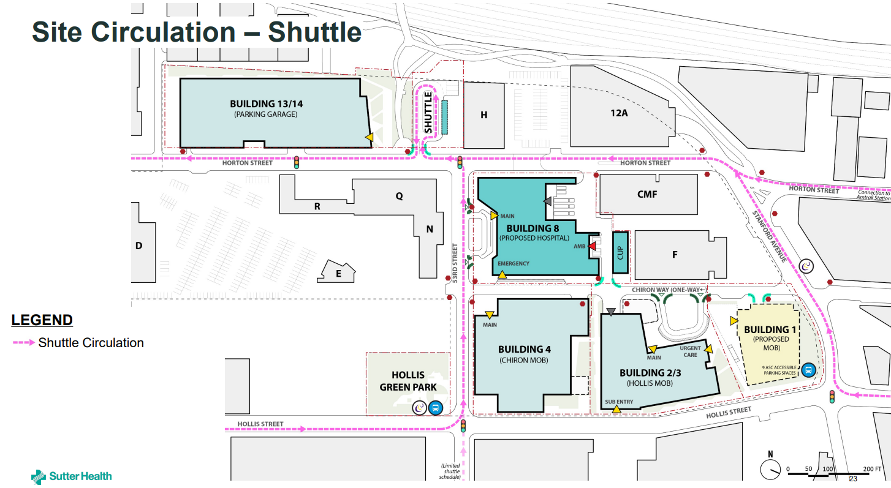

Slide 44
Anna Yates Traffic Observation
On Wednesday June 3, staff observed 53rd Street during Anna Yates pick-up/drop-off hours:
  8:00 - 9:00 am (traffic peak at 8:15 - 8:40 am)
  1:00 - 2:00 pm (traffic peak at 1:25 - 1:50 pm)
Congestion concentrated in the loading zone and at the school entrance
Double loading, queues in eastbound direction

Slide 45
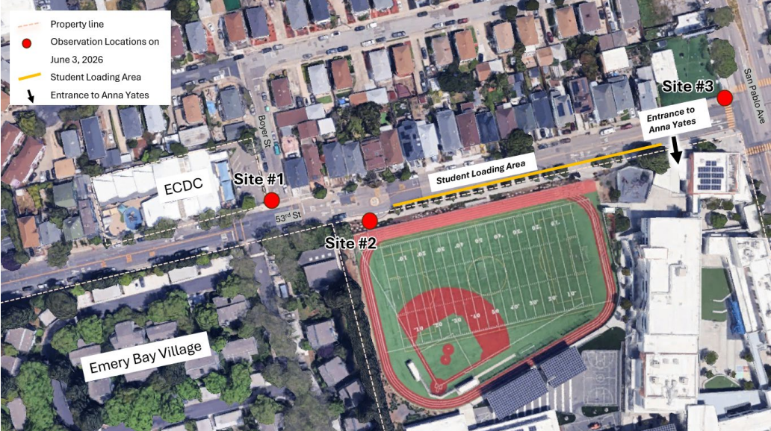
Anna Yates Traffic Observation, cont.

Slide 46
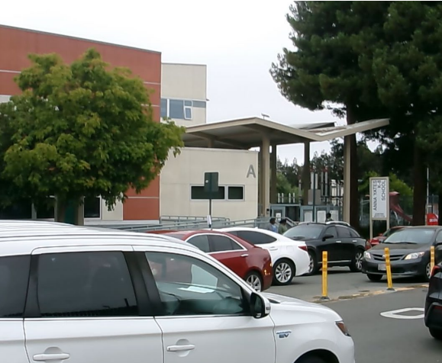
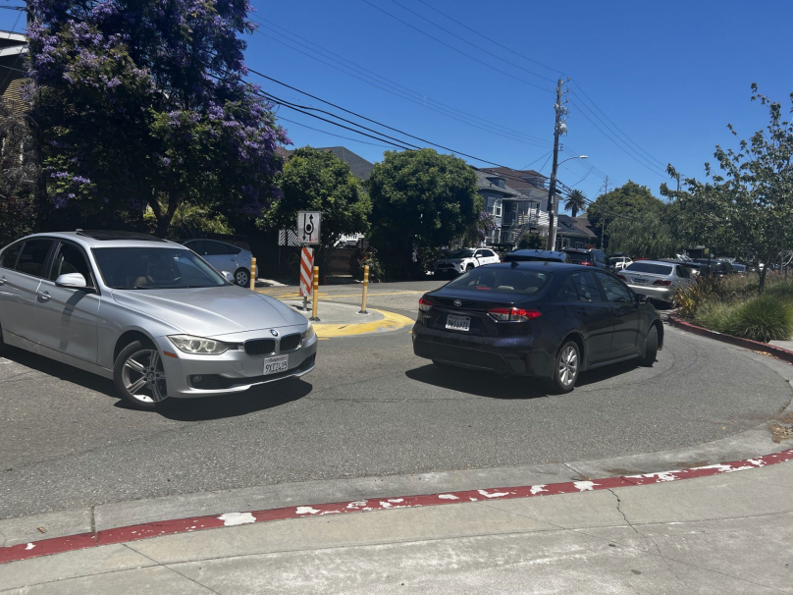
Anna Yates Traffic Observation, cont.
Morning (8:30 am)
Afternoon (1:30 pm)

Slide 47
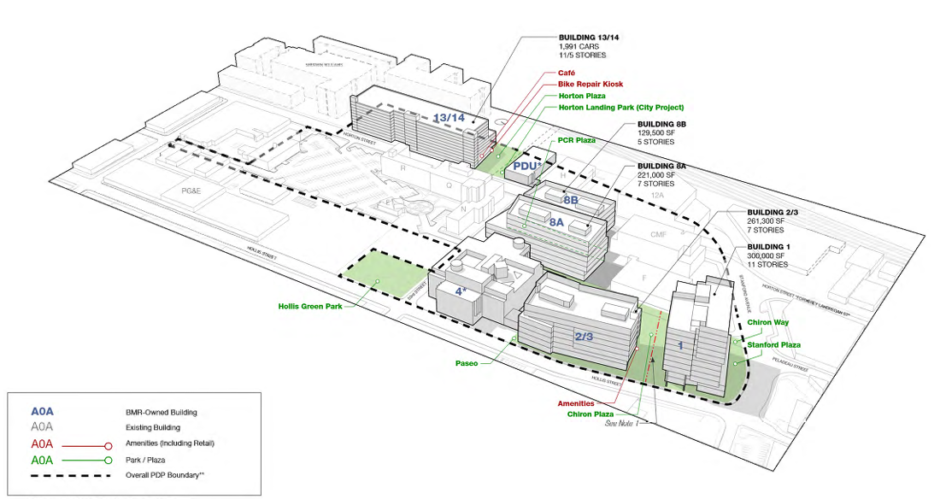
BMR Massing

