Slide 1


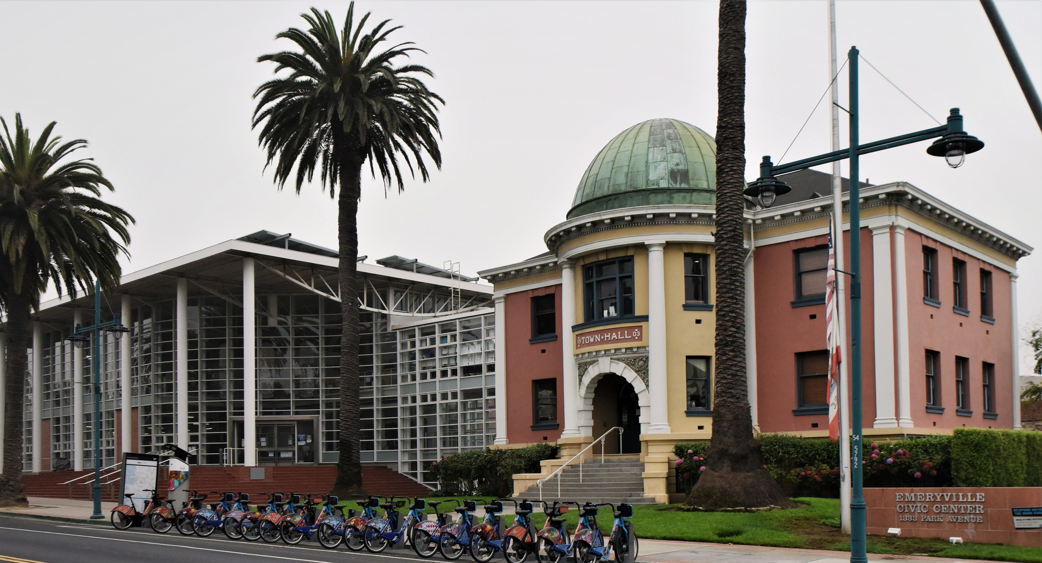

LABOR STANDARDS TRAINING
MINIMUM WAGE &
PAID SICK LEAVE ORDINANCE
EMC 5-37

Slide 2


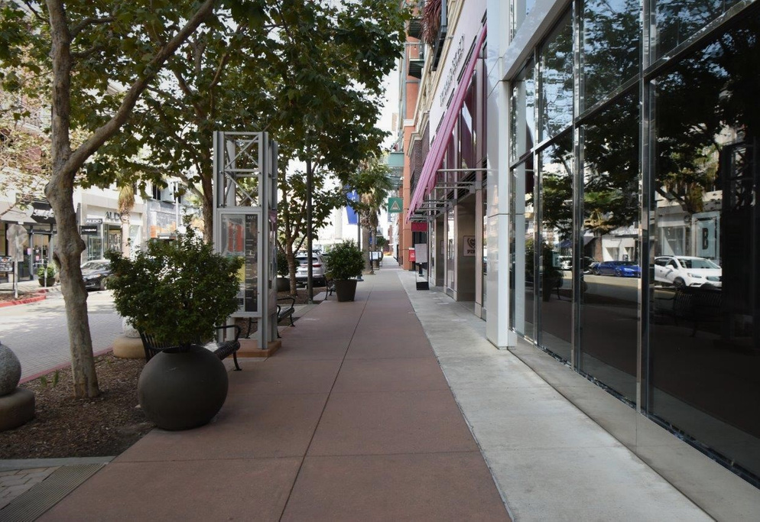
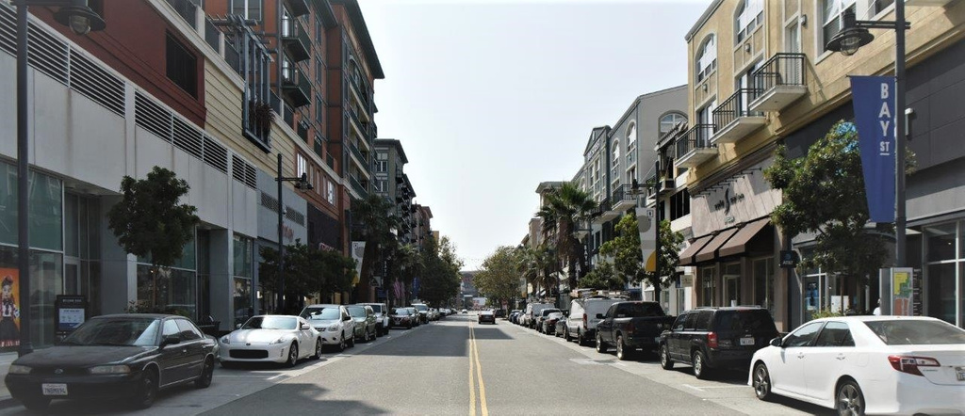
TOPICS
Emeryville Municipal Code 5-37
  Minimum Wage Ordinance
  Paid Sick Leave
  Service Charge Law
How to File a Complaint
Contact Us

Slide 3

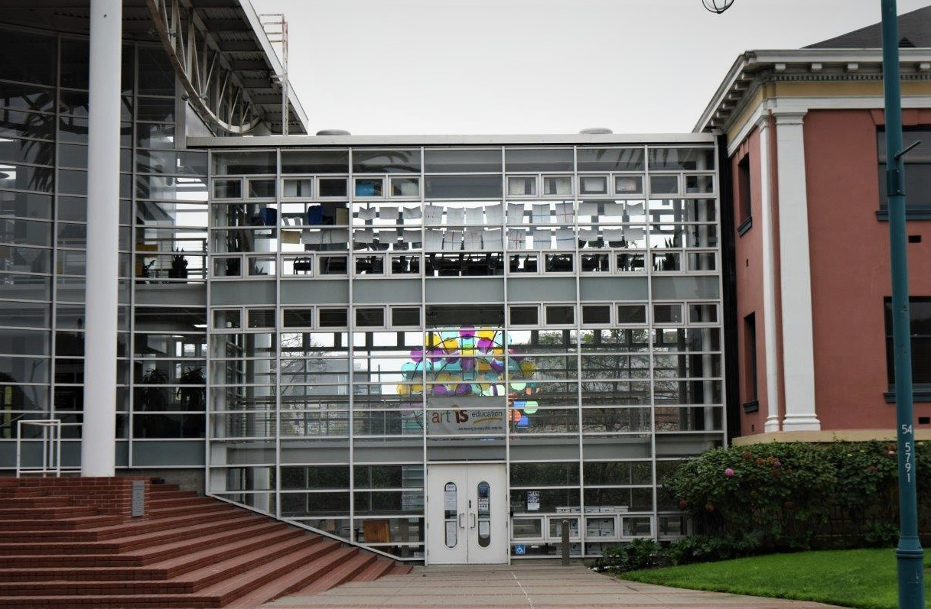
MIN WAGE AND PAID SICK LEAVE, EMC 5-37
Adopted July 2015
On July 2, 2015, the City of Emeryville adopted Emeryville Municipal Code (EMC) 5-37, that required businesses to increase the minimum wage and provide paid sick leave hours to its employees.

Slide 4
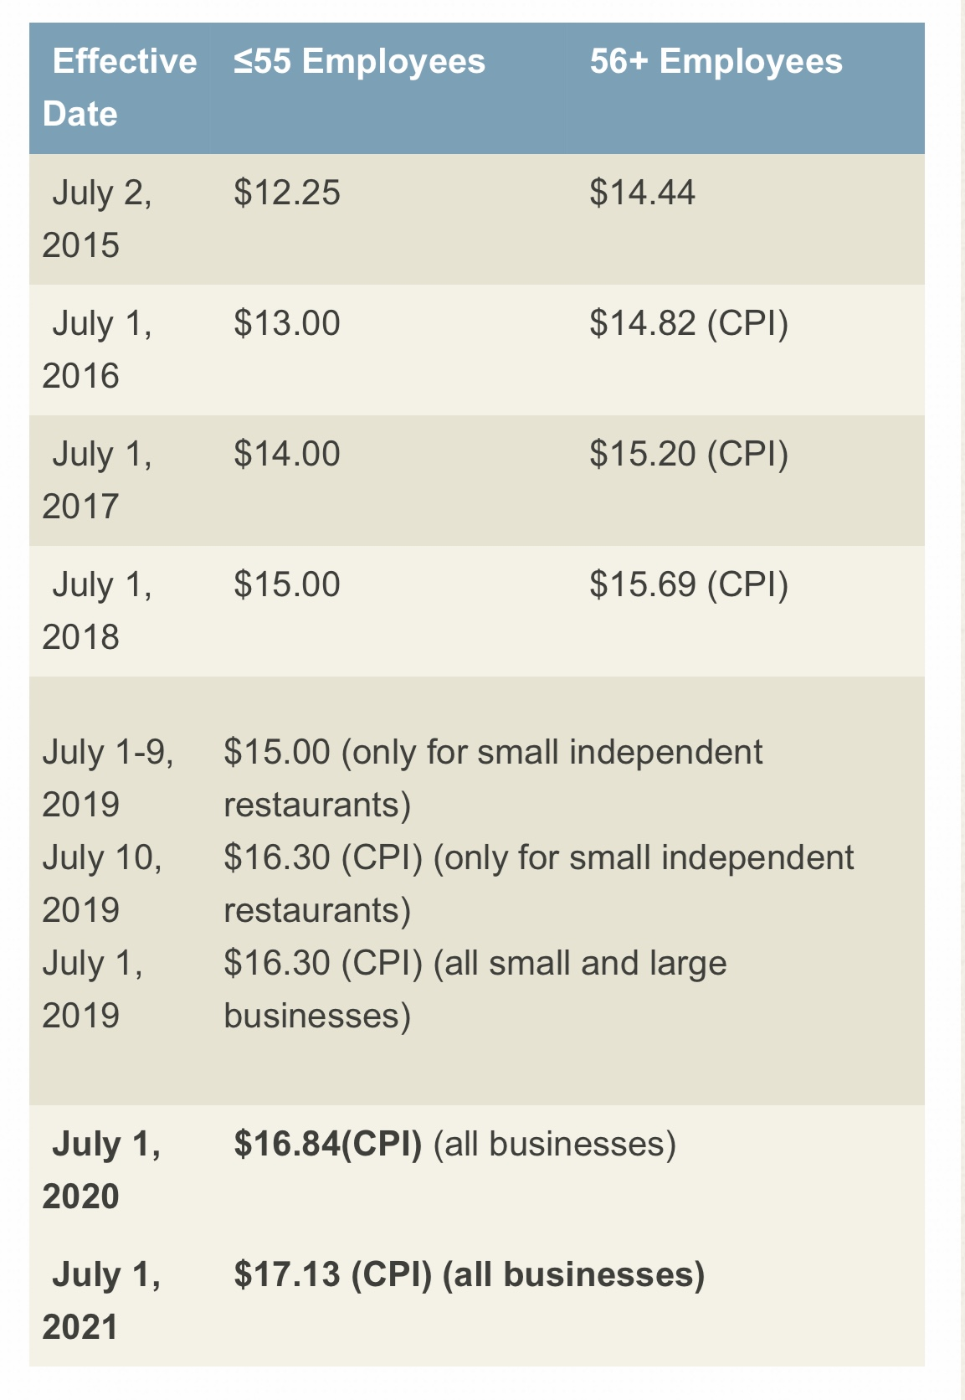
Minimum Wage Ordinance:
Small employers (55 or less employees) were required to increase minimum wage to $12.25, while large employers (56 or more employees) were required to increase their wages to $14.44 in July 2015. The ordinance also required gradual increases every year after.

Slide 5

MINIMUM WAGE
As of July 1, 2021, minimum wage in Emeryville will reach $17.13 for ALL employers.
The minimum wage in the City of Emeryville is the highest in the state of California.
Employers are required to post updated minimum wage posters in accessible areas to employees.
Updated posters can be downloaded from the
City of Emeryville website.

Slide 6


Paid Sick Leave(PSL)
EMC 5-37 requires :
  SMALL businesses must provide its employees 48 hours of paid sick leave hours per year
  LARGE businesses must provide 72 PSL hours
  PSL can be used beginning the 90th day of hire
  Total accrued PSL hours can be used
  Unused PSL hours can be carried over to the next year but can be capped at the employer’s discretion
Paid Sick Leave use:
PSL hours can be used for personal sick use
OR to care for:
  a family member
  Domestic partner or designated PSL person
  Service animal, signal or guide dog

Slide 7
HOW DO I KNOW IF I WORK FOR A SMALL OR LARGE EMPLOYER?
SMALL BUSINESS
LARGE BUSINESS
EMPLOYERS WITH 56 OR MORE EMPLOYEES IN THE CITY OF EMERYVILLE
EMPLOYER THAT EMPLOYS 55 OR LESS EMPLOYEES IN THE CITY OF EMERYVILLE
EXAMPLE 1:
EXAMPLE 2:
DONNA’S DONUT SHOP HAS 3 LOCATIONS IN EMERYVILLE. EACH LOCATION HAS 20 EMPLOYEES.
BOB’S BURGERS HAS 2 FRANCHISES IN THE CITY.
EACH LOCATION HAS 25 EMPLOYEES.
IS THIS A SMALL OR LARGE EMPLOYER?
IS THIS A SMALL OR LARGE EMPLOYER?

Slide 8
WHO’S ELIGIBILE FOR PAID SICK LEAVE?
FULL TIME
2. PART-TIME
3. TEMPORARY
4. SEASONAL
5. CONTRACTORS
6. ANY EMPLOYEE WHO WORKS A MINIMUM OF 2 HOURS IN EMERYVILLE EACH WEEK

Slide 9
DOWNLOAD MIN WAGE & PAID SICK LEAVE ORDINANCE PSL DESIGNATION FORM HERE!
WWW.CI.EMERYVILLE.CA.US

Slide 10







HOSPITALITY SERVICE CHARGE
Ordinance requires employers to pay employees the ENTIRETY of charges/tips collected for services rendered for which the charges or tips are collected.

Slide 11
* PLEASE NOTE: ORDINANCE REQUIRES ENTIRETY OF SERVICE CHARGES COLLECTED BE PAID TO EMPLOYEES FOR WHICH THE CHARGES WERE COLLECTED UNLESS THE EMPLOYER HAS A POLICY STIPULATING THAT THESE CHARGES ARE USED TO COVER BUSINESS EXPENSES INCURRED.
DOWNLOAD SERVICE CHARGE LAW POSTER BY CLICKING HERE!
OR VISITING US AT: WWW.CI.EMERYVILLE.CA.US

Slide 12
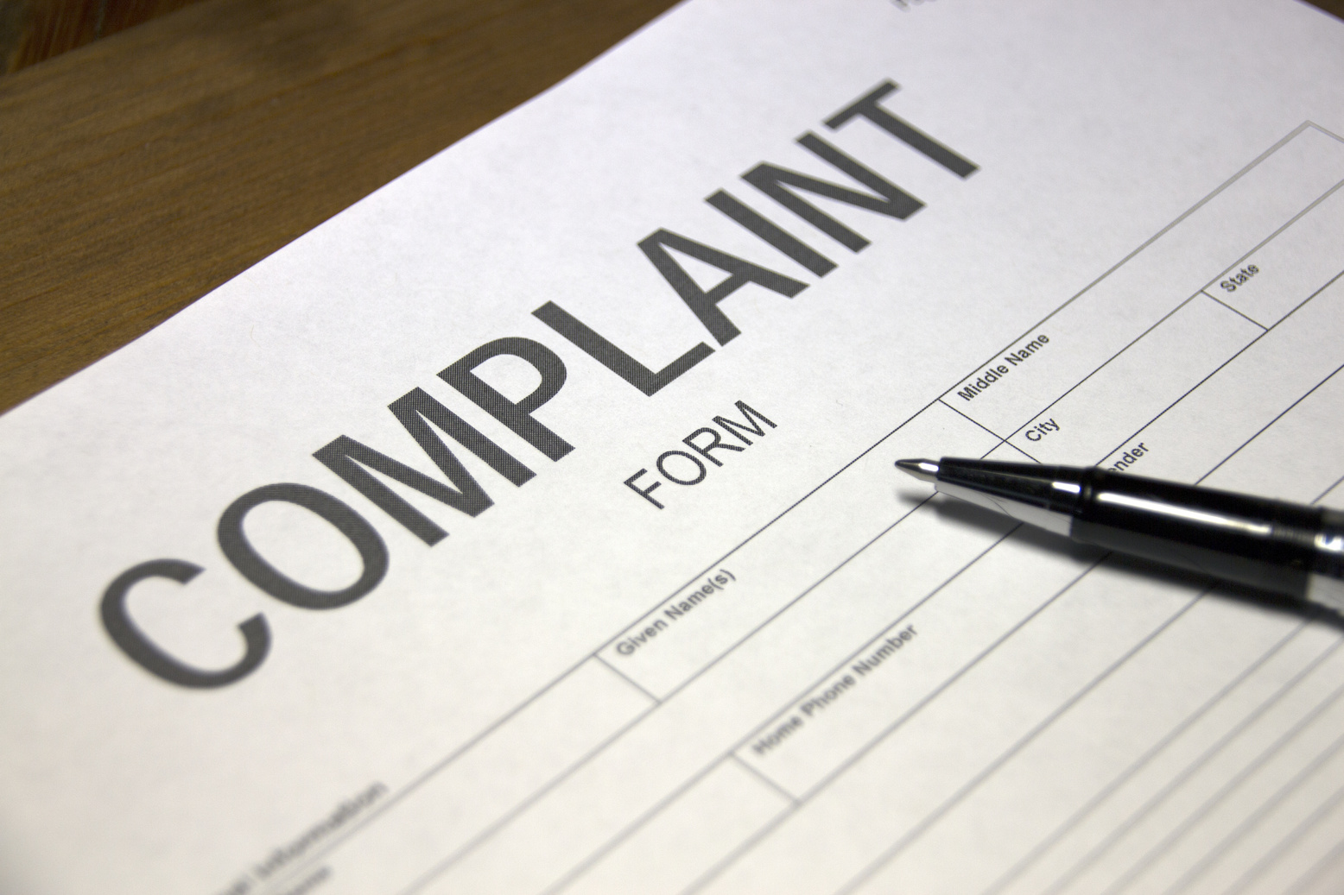


FILE A COMPLAINT
You can file a complaint with the City of Emeryville, if you:
  DO NOT receive the min wage
  DO NOT receive paid sick leave
  DO NOT receive notice to designate PSL person
  DENIED use of your PSL hours
  Are a Hospitality worker and:
    DO NOT receive notice of distribution of service charges
    DO NOT receive service charges

Slide 13
DOWNLOAD DECLARATION FORM HERE!
OR VISITING US AT:
WWW.CI.EMERYVILLE.CA.US

Slide 14




CONTACT US
Telephone
(510) 569-4300
(510) 596-4351
Email
minwage@emeryville.org
Main Office
1333 Park Ave.,
Emeryville, CA 94608

Slide 15

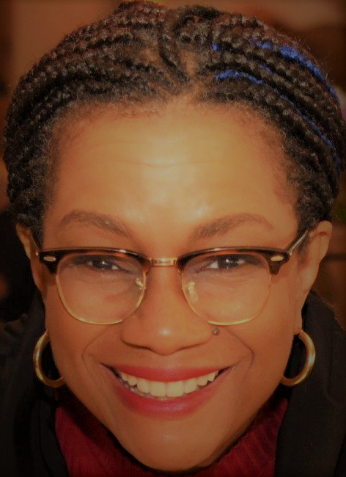

THANK YOU!
PLEASE REFER TO OUR LABOR STANDARD QUIZ NEXT
April Shabazz
Lin Robertson
Lucy Sanchez
Management Analyst
City of Emeryville
Labor Compliance Consultant
Labor Compliance Consultant
(English/Spanish)
(English/Spanish)
(English)

