Slide 1






Emeryville Housing Committee
^{Wednesday, June 1, 2022}
DRAFT 2023-2031 HOUSING ELEMENT

Slide 2

2023-2031 HOUSING ELEMENT
Presentation:
Schedule
Overview of Housing Element Requirements and Highlights
RHNA Allocation
Site Inventory Overview
Goals, Policies & Programs Overview & Highlights

Slide 3
2023-2031 HOUSING ELEMENT: Schedule
What | When
Housing Element Kick-Off | March 2021
Housing Committee: Overview | April 7, 2021
Community Workshop #1 | June 29, 2021
Housing Committee: Accomplishments, Goals, Programs, and Policies | July 7, 2021
Housing Committee: Housing Needs Assessment and Assessment of Fair Housing | October 6, 2021
Planning Commission: Study Session Housing Element Overview | October 28, 2021
City Council: Study Session Housing Element Overview | November 16, 2021
Housing Committee: Site Inventory and RHNA | December 1, 2021
Housing Committee: Housing Constraints, Resources and Opportunities | February 2, 2021
Community Workshop #2 | February 23, 2022

Slide 4
2023-2031 HOUSING ELEMENT: Schedule
What | When
Housing Element Kick-Off | March 2021
Housing Committee: Overview | April 7, 2021
Community Workshop #1 | June 29, 2021
Housing Committee: Accomplishments, Goals, Programs, and Policies | July 7, 2021
Housing Committee: Housing Needs Assessment and Assessment of Fair Housing | October 6, 2021
Planning Commission: Study Session Housing Element Overview | October 28, 2021
City Council: Study Session: Housing Element Overview | November 16, 2021
Housing Committee: Site Inventory and RHNA | December 1, 2021
Housing Committee: Housing Constraints, Resources and Opportunities | February 2, 2021
Community Workshop #2 | February 23, 2022

Slide 5
2023-2031 HOUSING ELEMENT: Schedule
What | When
Public Review Period of Draft | May 19-June 18 (30 days)
Planning Commission: Draft Review | May 26
Housing Committee: Draft Review | June 1
City Council: Draft Review | June 7
Integrate Public Comments | June 20 -July 1 (10 business days)
Post Revised Draft and Submit to HCD | July 5
HCD Reviews Admin Draft | July 6- October 3 (90 days)
City Address HCD Comments | October 4- October 18
City Resubmits to HCD | October 19
HCD Reviews Revised Admin Draft | October 19-December 17 (60 days)
Additional Revisions By City, if needed | December 19 – December 27
Planning Commission Recommends Adoption | January 26, 2023
ABAG Region Adoption Deadline | January 31, 2023
City Council Adopts | February 7, 2023
Grace Period for Adoption | May 31, 2023 (120 days)
Today

Slide 6
2023-2031 HOUSING ELEMENT
Overview of Housing Element Requirements and Highlights
Housing Needs Assessment (Chapter 3)
Constraints Analysis (Chapter 4)
Affirmatively Furthering Fair Housing (Chapter 5)
Housing Sites Inventory (Chapter 6)
Evaluation of Past Performance (Chapter 7)
Policies and Programs (Chapter 8)
Community Engagement (Appendix B)

Slide 7
2023-2031 HOUSING ELEMENT
Overview of Housing Element Requirements and Highlights
Housing Needs Assessment (Chapter 3)
Constraints Analysis (Chapter 4)
Affirmatively Furthering Fair Housing (Chapter 5)
Housing Sites Inventory (Chapter 6)
Evaluation of Past Performance (Chapter 7)
Policies and Programs (Chapter 8)
Community Engagement (Appendix B)

Slide 8
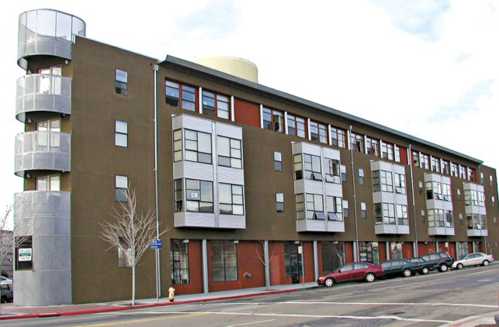
2023-2031 HOUSING ELEMENT
Overview and Highlights of
Housing Needs Assessment (Chapter 3)
Provides quantitative and descriptive analysis of existing and projected housing needs, and resources available to address these needs
Demographic and Housing Characteristics
Economic and Income Indicators (employment, jobs/housing balance)
Housing Costs and Affordability
Special Housing Needs (seniors, disabled)
Regional Housing Needs Allocation (RHNA)
Avalon Senior Housing

Slide 9
2023-2031 HOUSING ELEMENT
Overview and Highlights of
Constraints Analysis (Chapter 4)
Assesses governmental and non-governmental restraints to development including:
  Potential Governmental Constraints
    land use regulations
    residential development standards
    permits and procedures
  Environmental Considerations
    Hazards
    environmental regulations
    infrastructure
  Non-Governmental (Market) Constraints
    macroeconomy
    land and home costs
    financing availability

Slide 10
2023-2031 HOUSING ELEMENT
Overview and Highlights of
Affirmatively Furthering Fair Housing (Chapter 5)
AFFH means “taking meaningful actions, in addition to combating discrimination, that overcome patterns of segregation and foster inclusive communities free from barriers that restrict access to opportunity based on protected characteristics.”
  Outreach
  Assessment of Fair Housing Issues
  Patterns of Integration and Segregation
  Access to Opportunity
  Disproportionate Housing Need and Displacement Risk
  Enforcement and Outreach Capacity
  Site Inventory Analysis
  Potential Effect on Disproportionate Housing Needs & Displacement Risk
  Contributing Factors

Slide 11
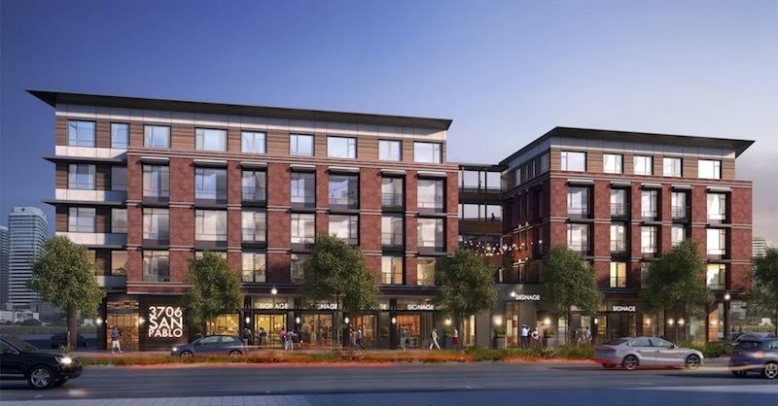
2023-2031 HOUSING ELEMENT
Overview and Highlights of
Evaluation of Past Performance (Chapter 7)
7 Goals in 2015 – 2023 Housing Element:
  Promoted Housing Rehabilitation Programs
  Affordable Housing Administration and Expenditure Plan adopted in Feb 2021
  Participated in homelessness prevention regional coordinating programs.
  Increased the mix of unit sizes; adopted Family Friendly Guidelines
  City funded accessibility improvements for residents with disabilities
  Prevented foreclosure of affordable unit and provided info for owners at risk
  Offered low-interest loans or grants to remediate housing development sites.
Estrella Vista

Slide 12
2023-2031 HOUSING ELEMENT
Overview and Highlights of
Community Engagement (Appendix B)
Promoted via social media postings, flyer distribution, posters displayed in local businesses, and direct e-mail
2 community workshops and 2 online surveys
Fair housing and service provider consultations,
5 Housing Committee meetings so far,
Planning Commission and City Council study sessions

Slide 13
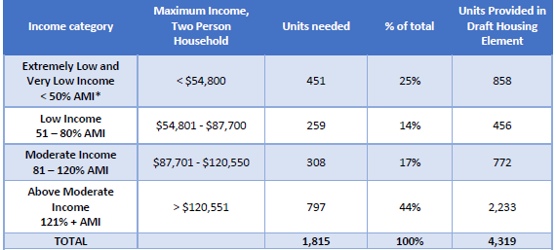
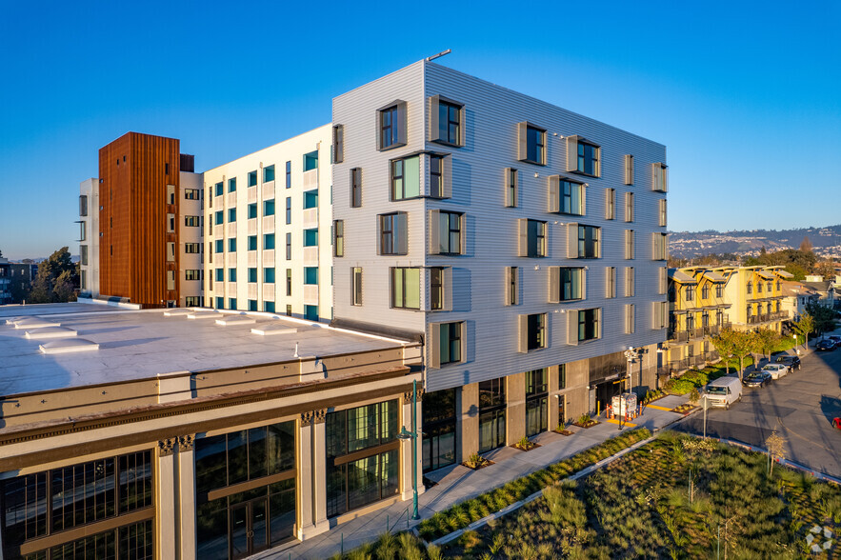
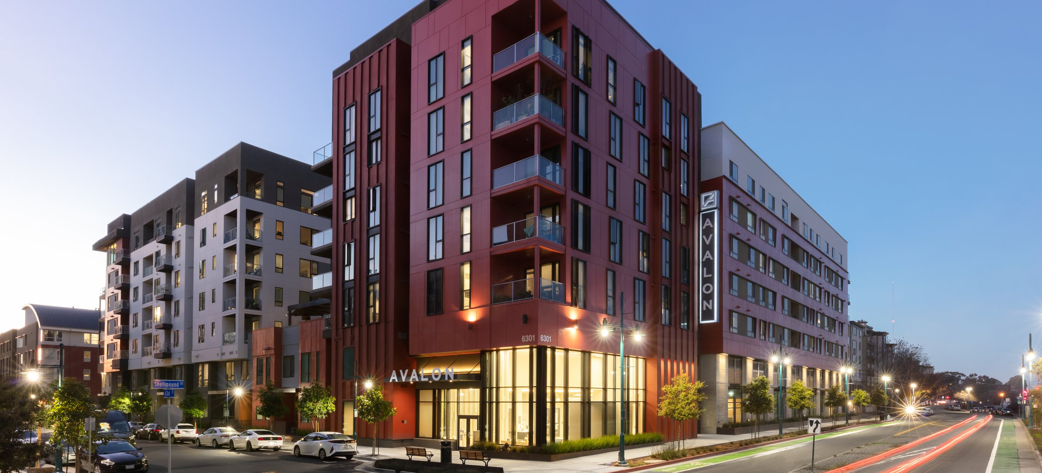
2023-2031 HOUSING ELEMENT
Regional Housing Needs Allocation (RHNA)
Avalon Public Market

Slide 14
2023-2031 HOUSING ELEMENT
Site Inventory Requirements & Assumptions
REQUIREMENTS
  Must demonstrate realistic capacity through zoning and development record
  Must demonstrate that proposed sites may be realistically developed
  Affirmatively Furthering Fair Housing
ASSUMPTIONS
  Realistic capacity is estimated at 80% of the base max
  When unit counts are known or proposed they are used

Slide 15
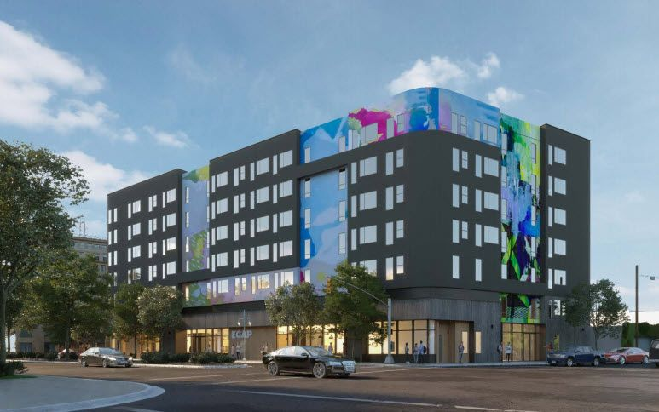
2023-2031 HOUSING ELEMENT
Planned & Approved Projects
Site No. | Project Name | Project Address | Total Unit Count
1 | Baker Metal Live/ Work | 1265 65th Street | 17
2 | Anton Evolve AKA Bayview Emeryville Apartments (Nady Site) | 6701 Shellmound Street | 186
3 | The Emory (Sherwin Williams) Building C | 1450 Sherwin Avenue | 122
4 | The Emory (Sherwin Williams) Building D | 1450 Sherwin Avenue | 184
5 | 65th Street Multi-Unit Residential Project | 1225 65th Street | 24
6 | Nellie Hannon Gateway | 3600-3620 San Pablo Avenue | 90
 |  | TOTAL | 623
Nellie Hannon Gateway
Entitled

Slide 16
2023-2031 HOUSING ELEMENT
Vacant & Underutilized Sites
 | Extremely Low | Very Low | Low | Moderate | Above Moderate | Total
Vacant 2 Sites* | 188 | 188 | 188 | 187 | 187 | 938
Underutilized 13 Sites | 199 | 205 | 209 | 549 | 1,566 | 2,728
Total | 387 | 393 | 397 | 736 | 1,753 | 3,666
2 Vacant Sites:
Corp Yard at 5890, 5900, and 6150 Christie Avenue
NE Corner of Shellmound Street at Christie Avenue (Bay Street Site B)

Slide 17
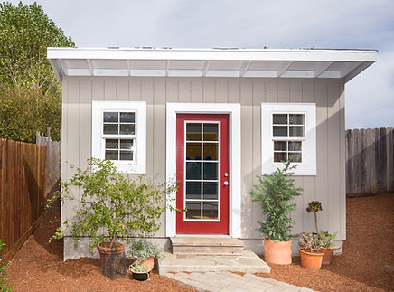
2023-2031 HOUSING ELEMENT
Accessory Dwelling Units (ADUs)
ADU DATA SINCE 2020
  9 Planning Permits for 12 units (six permits since regs changed in 2020)
  8 Approved Planning Permits, One Pending
  7 Building Permits for 6 Projects Approved
  5 Building Permits Issued
  2 Certificates of Occupancy
  BASED ON THIS DATA: INCLUDING 30 ADU UNITS IN RHNA

Slide 18
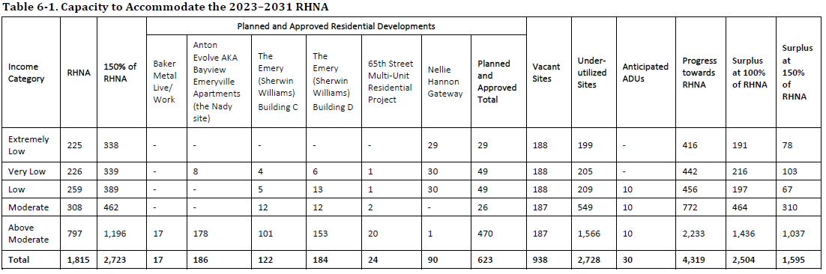
2023-2031 HOUSING ELEMENT
Total Proposed Sites & Units

Slide 19
2023-2031 HOUSING ELEMENT
Total Proposed Sites & Units

Slide 20
2023-2031 HOUSING ELEMENT
Total Proposed Sites & Units

Slide 21
2023-2031 HOUSING ELEMENT
Total Proposed Sites & Units

Slide 22
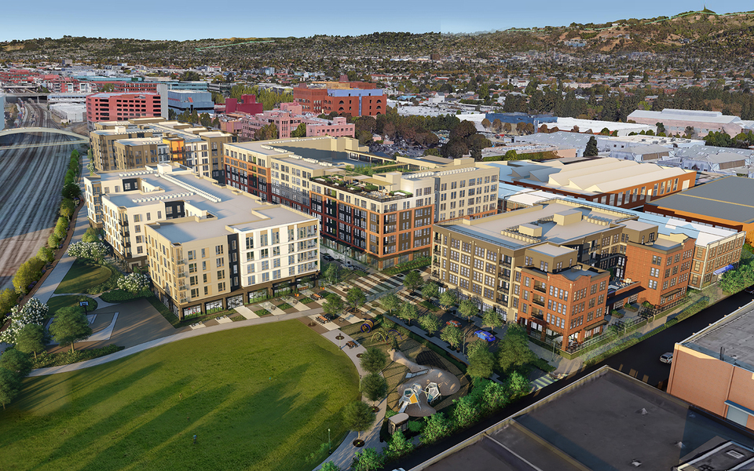
2023-2031 HOUSING ELEMENT
Total Proposed Sites & Units
Emeryville Cycle 6 RHNA Allocation | Extremely Low Income | Very Low Income | Low Income | Moderate Income | Above Moderate Income | Total
Residential Units | 225 | 226 | 259 | 308 | 797 | 1,815
150% Allocation | 338 | 339 | 389 | 462 | 1,196 | 2,723
Proposed | 416 | 442 | 456 | 772 | 2,233 | 4,319
The Emery
Under Construction

Slide 23
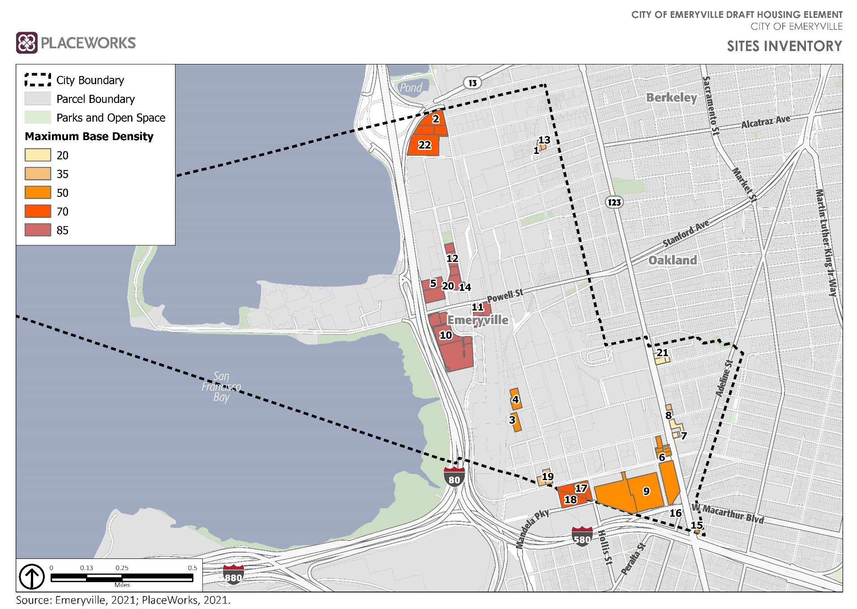
2023-2031 HOUSING ELEMENT

Slide 24
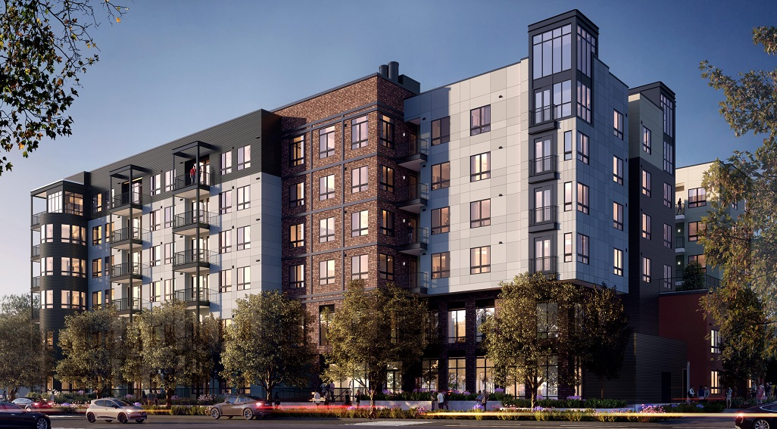
2023-2031 HOUSING ELEMENT
Confidence in Meeting RHNA Allocation
  Realistic Capacity is 185% over RHNA for extremely low, 280% over for above moderate
  Realistic Capacity of sites is VERY conservative
  Strong track record of developing housing on both RHNA and non RHNA sites
  Have demonstrated developability of proposed sites by:
    Contacting owners of identified sites
    Stating when sites are anticipated to change ownership or leases
    Conservative estimates used as parts of sites may be developed and existing uses partially maintained.
Bayview Emeryville Apartments
Under Construction

Slide 25
2023-2031 HOUSING ELEMENT
Goals, Policies, Programs Overview
Goals, Policies & Program Requirements
Guiding Principles & Framework
Housing Element Goals (Cycle 5 vs. Cycle 6)
Housing Element Policies (Cycle 5 vs. Cycle 6)
Programs (Planning & Zoning Focused)

Slide 26
2023-2031 HOUSING ELEMENT
Guiding Principles & Requirements
Policies must be relative to affirmatively furthering fair housing and to the maintenance, preservation, improvement, and development of housing.
Programs are a system of projects, procedures or services needed to achieve the goals and policies. Programs may assist in achieving various policies and goals .
    Programs should go beyond just “explore” and have various action steps so that meaningful updates are provided through the annual reporting process, beyond “continue to implement”.
    Timeframe are more flexible and are provided for each action within a program:
    Short Term (0-3 years)
    Mid Term (4-6 years)
    Long Term (7-8 years)
    Ongoing (All years)
Cycle 5
Goal
Policy
Policy
Program
Program
Cycle 6
Program
Policy
Goal
Policy
Goal

Slide 27
2023-2031 HOUSING ELEMENT
Program Requirements
    Accommodate the City’s RHNA.
    Develop housing to meet the needs of households at all income levels.
    Address and/or remove governmental and nongovernmental constraints
    Conserve and improve the condition of the existing affordable housing stock.
    Promote fair housing opportunities and promote housing throughout the community for all persons
    Preserve assisted housing developments for low income
    Incentivize and promote the creation of accessory dwelling units that can be offered at affordable rent.
    Identify the agencies responsible for implementation.
    Include a diligent effort by the local government to achieve public participation of all economic segments of the community.
    Identify actions related to mobility strategies and place-based strategies.

Slide 28
2023-2031 HOUSING ELEMENT
Housing Element Goals
Cycle 5
Cycle 6
H-1 Preservation: Preserve and improve the city’s existing neighborhoods and housing stock
H-2 Housing Development: Encourage the development of housing affordable to extremely low, very low-, and low-income households.
H-3 Special Needs: Promote the development of affordable housing for person with special needs
H-4 Housing Type: Provide a wide variety of housing types appropriate for households at all socioeconomic levels and with a variety of lifestyles and preferences.
H-5 Fair Housing: Promote equal opportunity in housing
H-6 Housing Needs: Improve the balance in housing tenure and unit sizes to specifically address the need for family-friendly housing and increase owner occupancy.
H-7 Sustainability: Promote environmental responsibility and long-term sustainability in residential development through the remediation of brownfields and promotion of “green” and “healthy” housing development
H-1 Housing Development: Facilitate the construction of a wide variety of housing types for various income levels, in a manner that promotes environmental responsibility and long-term sustainability, in support of meeting the City's Regional Housing Needs Allocation (RHNA).
H-2 Preservation: Conserve and improve the condition of the existing housing stock to enhance the livability of neighborhood(s) for all residents.
H-3 Housing Needs: Ensure housing is accessible and affordable to very-low-, low-, and moderate-income residents, with a priority for those with special needs.
H-4 Fair Housing: Ensure all community members have equitable access to safe, sanitary and affordable housing as protected under State and Federal fair housing laws.
H-5 Constraints: Reduce or remove governmental and nongovernmental constraints to the development, improvement, and maintenance of housing, where feasible.

Slide 29
2023-2031 HOUSING ELEMENT
Housing Element Policies
GOAL 1: DEVELOPMENT | H-1-1 | Incentives/Concessions: Provide monetary and regulatory incentives for residential projects constructed specifically for lower- and moderate-income households.
 | H-1-2 | Housing Type: Explore innovative and creative housing options that provide greater flexibility in development and/or use, facilitate affordability, and meet the housing needs of all residents in the City.
 | H-1-3 | Environmental: Encourage the remediation of former industrial sites to create safe sites for housing development.
 | H-1-4 | Sustainability: Encourage housing development that provides clean indoor air, maximizes energy and water efficiency, addresses storm water treatment, uses high-quality, eco-friendly building materials and aligns with regional greenhouse gas reduction strategies
GOAL 2: PRESERVATION | H-2-1 | Existing Conditions: Facilitate the rehabilitation of the City’s existing housing stock to correct housing deficiencies, increase the useful life, and increase accessibility for all residents
 | H-2-2 | Sustainability: Support energy-conserving programs in the rehabilitation of affordable housing to reduce household energy costs, improve air quality, and mitigate potential impacts of climate change in the region.
 | H-2-3 | At-Risk: Preserve “at-risk” affordable units through monitoring and partnering, working with nonprofits, and exploring available funding sources to preserve affordability.
 | H-2-4 | Homeownership: Promote homeownership opportunities and support current homeowners in retaining their homeownership status.
GOAL 3: HOUSING NEEDS | H-3-1 | Household Affordability: Utilize available federal, state, and local financing sources and subsidies to assist in making housing more affordable to very low-, low-, and moderate-income households.
 | H-3-2 | Special Needs: Support and promote the development of housing that is accessible to special needs residents, including seniors, disabled households, large families, the homeless, and transitional foster youth, through measures such as transitional supportive housing, ensuring reasonable accommodation, and the provision of emergency shelters.
NEW
NEW
NEW

Slide 30
2023-2031 HOUSING ELEMENT
Housing Element Policies
GOAL 4: FAIR HOUSING | H-4-1 | Discrimination: The City shall take meaningful action toward the goal of eliminating housing discrimination and providing current and future residents access to housing opportunity.
 | H-4-2 | Outreach: Facilitate transparent decision-making processes through public engagement and participation, supported by the development of clear and inclusive outreach materials, and the expanded and innovative use of a variety of public engagement tools.
 | H-4-3 | Displacement: The City shall explore options to strengthen eviction prevention and tenant displacement measures.
 | H-4-4 | Access to Opportunity: The City shall support collaborative efforts to connect low-income residents with financial empowerment resources, homeownership programs, small business assistance, living wage jobs, affordable childcare, and workforce training resources and services.
 | H-4-5 | Segregation: The City shall promote mixed income neighborhoods with an equitable distribution of housing types for people of all incomes throughout the City by encouraging new affordable housing in high resource areas.
 | H-4-6 | Quality of Life: Maintain and enhance the quality of life within neighborhoods, including those identified as low resource and/or disadvantaged, by providing adequate maintenance to streets, sidewalks, parks and other community facilities.
GOAL 5: CONSTRAINTS | H-5-1 | Zoning: Monitor Title 9 of the Municipal Code and other regulations to ensure that the City's policies and regulations do not inappropriately constrain housing development and affordability.
 | H-5-2 | Government: Monitor State and federal housing-related legislation, and update City plans, ordinances, and processes as appropriate to remove or reduce governmental constraints.
 | H-5-3 | Non-government: Monitor non-governmental constraints, such as interest rates, construction costs, and others through consultation with developers, lenders and other entities directly involved in the provision of housing. Should non-governmental constraints be identified that are related to City policies, the City may modify its policies and procedures if City actions would help to reduce those constraints.
NEW
NEW
NEW
NEW
NEW
NEW
NEW
NEW
NEW

Slide 31
2023-2031 HOUSING ELEMENT
# | DESCRIPTION | POLICIES | TIMEFRAME
A | Housing Development Regulatory Programs. Affordable Housing Program. Reduce # of units required in an ownership project below 10. Eliminate reference to impact fees so all residential rental projects must include % of affordable units. Increase % of required affordable housing units above 12% for very low and low-income Add option to produce smaller % of affordable units if units are targeted to extremely low and very low people with developmental disabilities 2. Development Bonus Programs. Analyze what the new % of affordable housing units shall be for Community Benefit points | H-1-1, H-1-2, H-3-2, H-5-2 | Evaluate & Adopt AHP- Short Term Evaluate & Adopt DBP- Short Term Implement AHP & DBP– Ongoing
D | Accessory Dwelling Units. Promote and incentivize the development of ADUs and JADUs. Develop ADU guidance materials Create a frequently-asked-questions webpage on the City’s website Explore initiatives such as developing a loan program for homeowners to construct ADUs affordable to lower-income households Meet with property owners to discuss capacity for ADUs in multi-unit developments. | H-1-1, H-1-2, H-4-2 | Develop Guidance - Short Term Develop Financing Tool - Mid Term Implement – Ongoing Update Website - Annually

Slide 32
2023-2031 HOUSING ELEMENT
# | DESCRIPTION | POLICIES | TIMEFRAME
R | Family Friendly Housing. Promote housing designs and unit mix to attract multigenerational households Encouraging more bedrooms (including four-bedroom units), usable outdoor open space for multigenerational use, and multipurpose rooms. Explore options to expand regulatory incentives to encourage the development of larger units. Expand Community Benefits Program to provide incentive for four- bedroom units and/or amend Affordable Housing Program to include an option to provide a percentage of affordable family-friendly units (3+ beds). | H-1-1, H-3-2 | Develop Regulatory Incentive – Mid Term Implement - Ongoing
X | Homeowner Rehabilitation and Repair Program Support and advertise the Rebuilding Together Minor Home Repair Program, Renew Alameda County Program and Alameda County Healthy Home Minor Home Repair Program Create a rehab program to address all housing units in Low Resource areas to address overall conditions of the area. Survey Condominium developments with HOAs to determine housing conditions, rehab and accessibility needs for owners and the property, as a whole Add home maintenance education resources to website | H-1-1, H-2-1, H-4-2 | Implement -Ongoing Survey HOAs- Short Term Develop Financing Incentive -Mid Term Update Website -Annually
EE | Resident Engagement Evaluate Committee and Commission Membership to determine if its reflective of the socio-economic and racial mix of Emeryville Enhance Outreach Efforts, when vacancies occur to attract a more diverse background of participants Restructure Housing Committee to have at least (1) BMR Resident, (1) Tenant, and (1) Homeowner. | H-4-2 | Evaluate Committee Demographics- Short Term Committee Restructure (Mid Term

Slide 33
2023-2031 HOUSING ELEMENT
# | DESCRIPTION | POLICIES | TIMEFRAME
FF | Access to Information Ensure public information is up to date at City Hall, website, newsflash and social media Public information materials are available in multiple languages and meet ADA standards Identify vulnerable to displacement neighborhoods and target marketing efforts to connect with households Utilize Housing Portal Mailserve to perform outreach on incentives, programs and housing opportunities Develop targeted marketing plan and coordinate with community-based partners to promote programs for persons with disabilities, housing rights and access to legal aid. Establish communication channel with participants at ECCL, ECDC and EUSD | H-4-2 | Housing Portal Outreach- Monthly Update Website – Quarterly Multi-lingual Marketing Materials –Short Term Targeted Marketing Plan – Short Term Parent Communication – Short Term
OO | Housing for Seniors Seek funding to support Senior Center Housing Case Manager Evaluate feasibility of a Shared Housing Program Redevelop 4300 San Pablo Site Implement Housing Domain actions of Age Friendly Action Plan Seek opportunities to develop Residential Care Facilities for the Elderly and Independent Senior Housing | H-1-2; H-3-2; H-4-2 | Onboard Senior Housing Case Manager –Short Term Evaluate Shared Housing – Short Term Develop Site – Mid Term Implement AFAP- Ongoing Seek Senior Housing - Ongoing
PP | Affirmative Fair Housing Marketing Plan Marketing Plans updated every 5 years Marketing Plans to identify underserved population and special outreach efforts Collect race and ethnicity data for BMR residents and evaluate if marketing methods need to be updated or if barriers in resident selection criteria exist Require BMR Property Managers to participate in Fair Housing Training every 2 years Amend Resale Restriction Agreement for future BMR resales to require 3rd party to assist in selection of new buyer via a lottery process | H-4-1 | Update Marketing Plan – Short Term Collect/Evaluate Demographic Data – Short Term Fair Housing Training – Ongoing Revise BMR Resale Requirement – Short Term

Slide 34
2023-2031 HOUSING ELEMENT
# | DESCRIPTION | POLICIES | TIMEFRAME
RR | Affordable Housing Platform Collaborate on design and implementation of Alameda County Affordable Housing Portal Support the development of Bay Area Regional Housing Portal (“Doorway”) Modify the Affordable Housing Covenant to require utilization of the platform(s) for leasing BMR units | H-3-2; H-4-1, H-4-2, H-5-1 | Support programs – Ongoing Revise Regulatory Agreement – Short Term
UU | Universal Design. Evaluate how to incorporate Universal Design Features into Planning Regulations beyond what is currently being implemented. | H-1-2, H-3-2 | Assess – Short Term Adopt – Mid Term

Slide 35
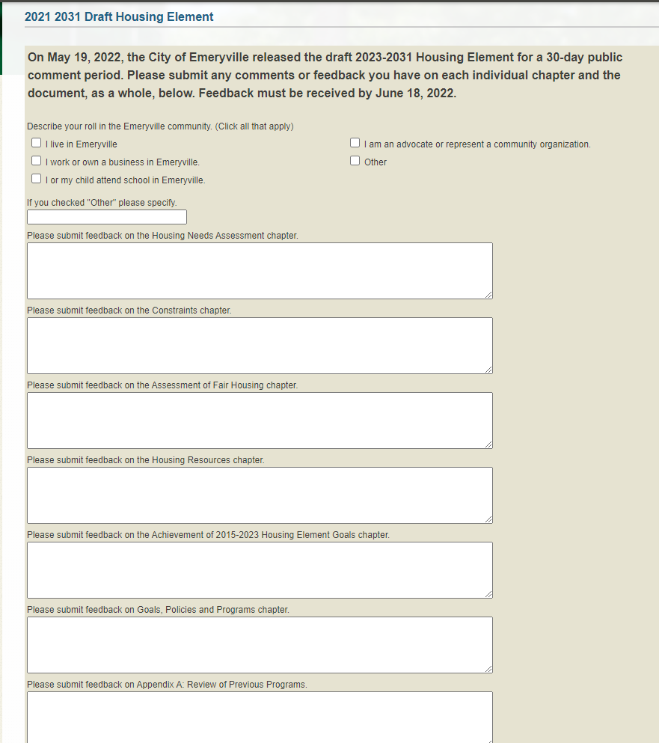
2023-2031 HOUSING ELEMENT
Public Comment Period
Public Comments will be accepted until June 17, 2022, for consideration into the Draft Housing Element to be submitted to HCD.
Submit comment via the Online Feedback Form
https://www.ci.emeryville.ca.us/1403/2023-2031-Housing-Element

